Slide 1
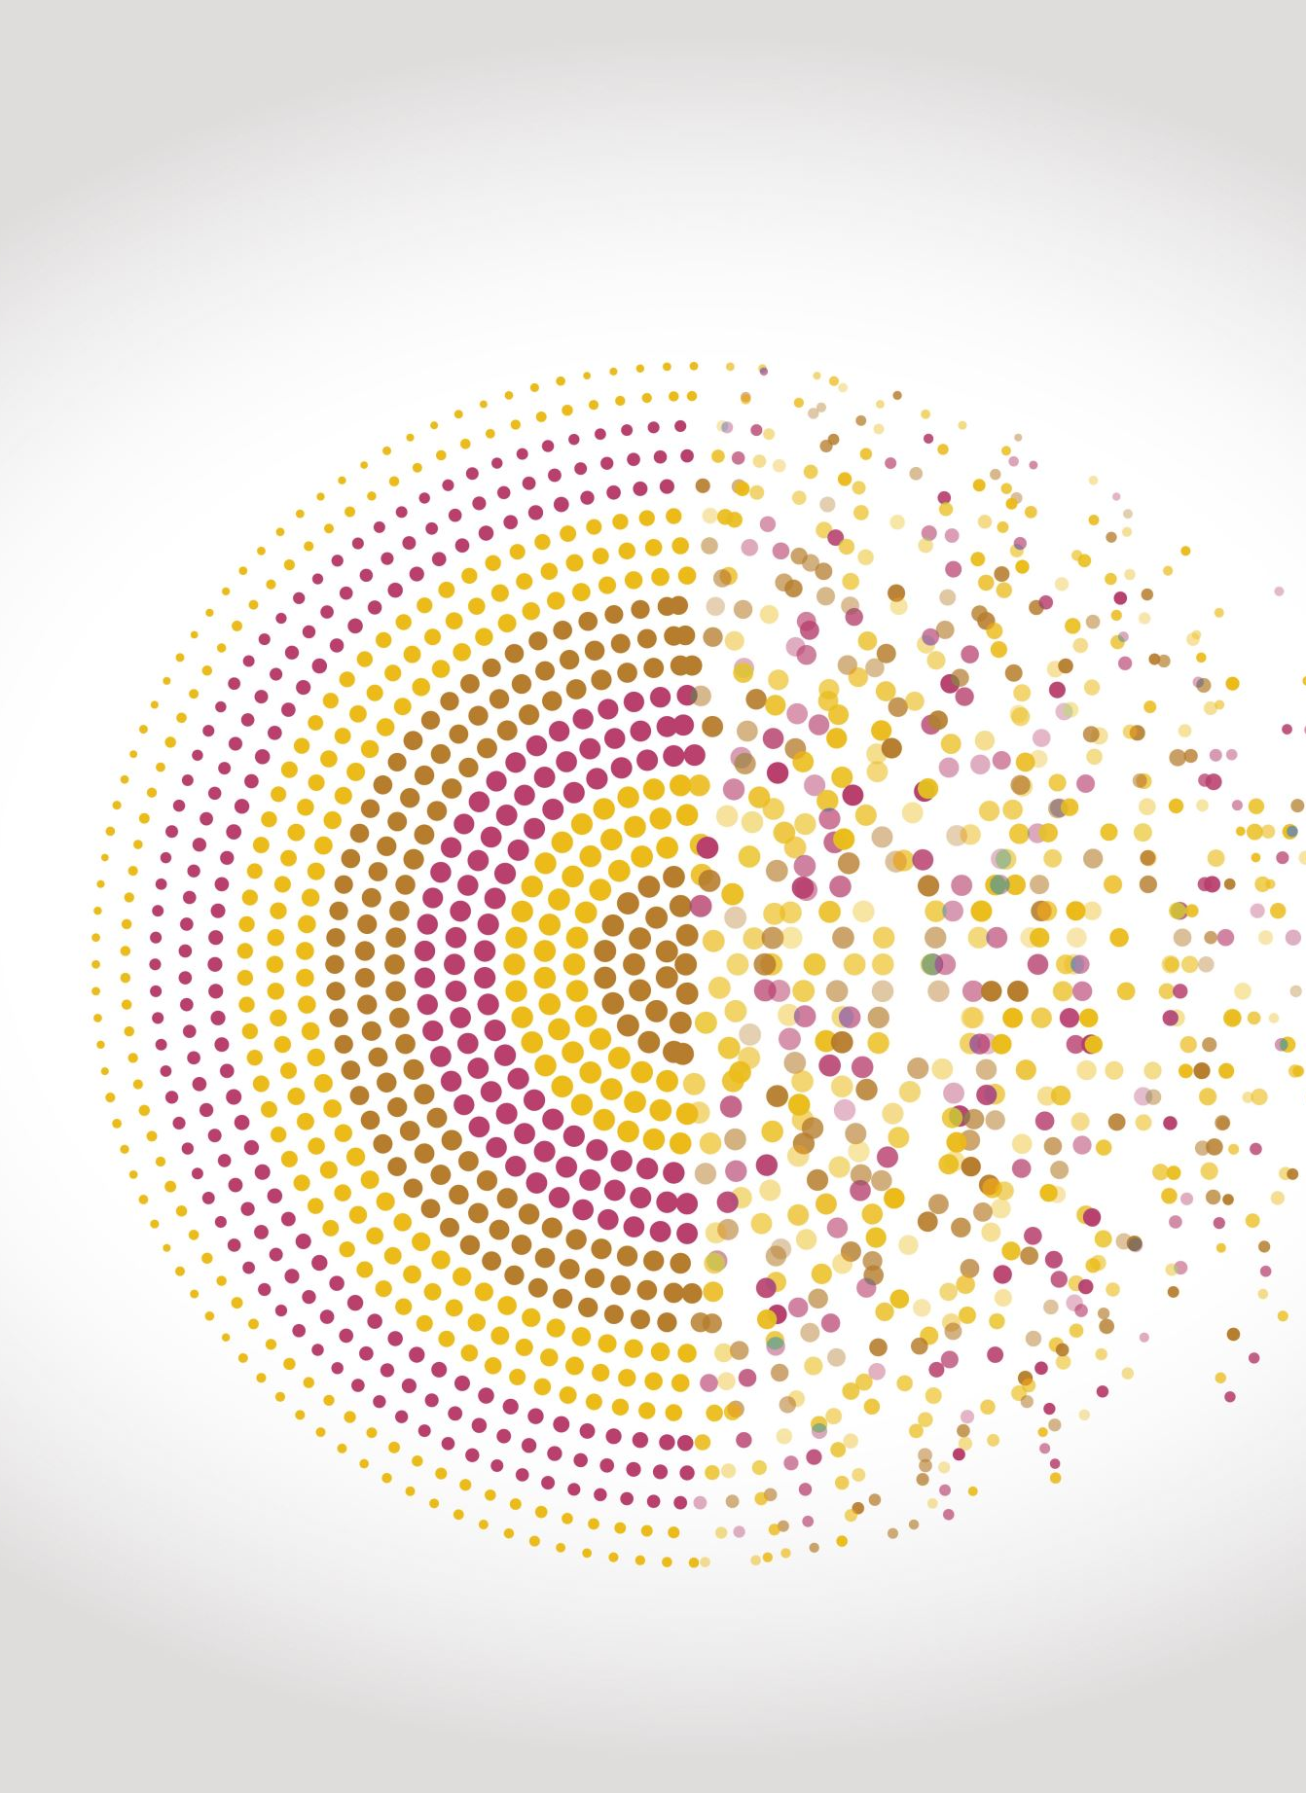
Resume/CV Parsing
Harshitha Girish – 011809582
Mahesh Kumar Srinivas - 011845961
Sharath Kumar Karnati - 011852253
Sreehari Guruprasad – 011809587

Slide 2
Introduction:
Hundreds of resumes flood HR desks for each job opening, overwhelming recruiters and slowing down candidate selection.
Resume parser/analyzers offer a solution by efficiently transforming large volumes of resume data into organized formats, extracting key details such as skills and experience.
This not only streamlines HR processes but also aids job seekers by providing insights, identifying errors, and suggesting improvements to enhance their resumes.
Our project aims to develop and deploy a resume parser tool using advanced technologies like NLP and machine learning to automatically extract and organize crucial data from various resume formats.

Slide 3
Objective:
Our goal is to develop a tool capable of extracting essential details from resumes, including contact information, education, experience, and skills.
This project aims to assist both recruiters and candidates by streamlining the job process, allowing them to focus their time and efforts on more productive tasks.

Slide 4
Dataset:
We utilized a Kaggle dataset containing over 2400 resumes for our project.
The process involved extracting text from PDF files using PyPDF2, converting it to lowercase, removing special characters and punctuation, tokenizing the text, eliminating stop words, lemmatizing words, and finally, vectorizing the text for machine learning analysis.
This comprehensive approach ensured the extraction of meaningful information while standardizing and preparing the data for analysis.

Slide 5
Methodology:
Data Collection
Data cleaning & Preprocessing
Feature Extraction
NLP Implementation
Cosine Similarity
K-nearest neighbors
Model Evaluation

Slide 6
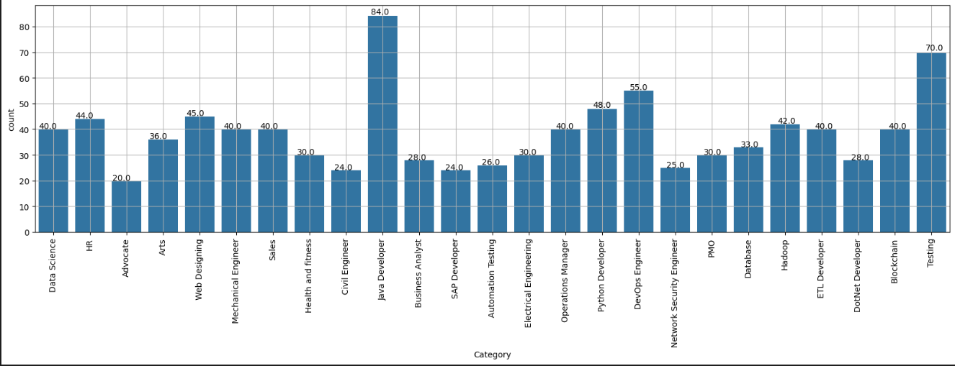
Results:

Slide 7
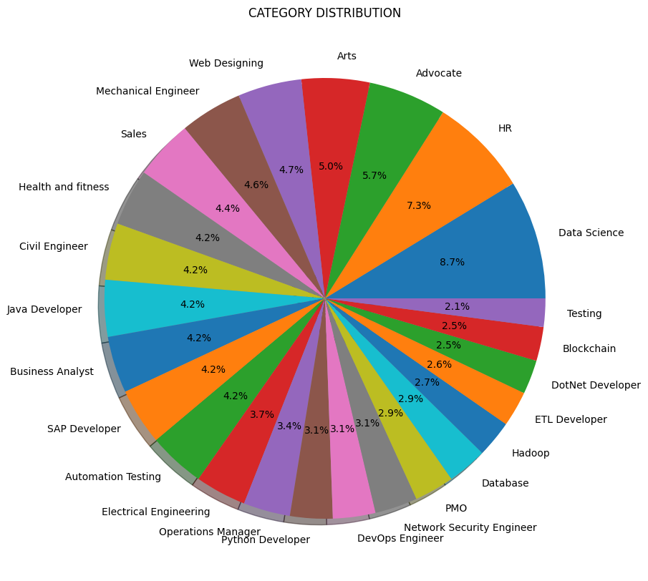

Slide 8
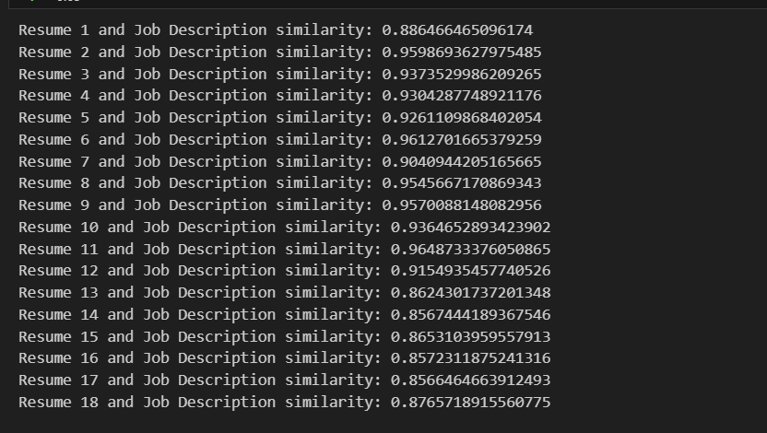

Slide 9
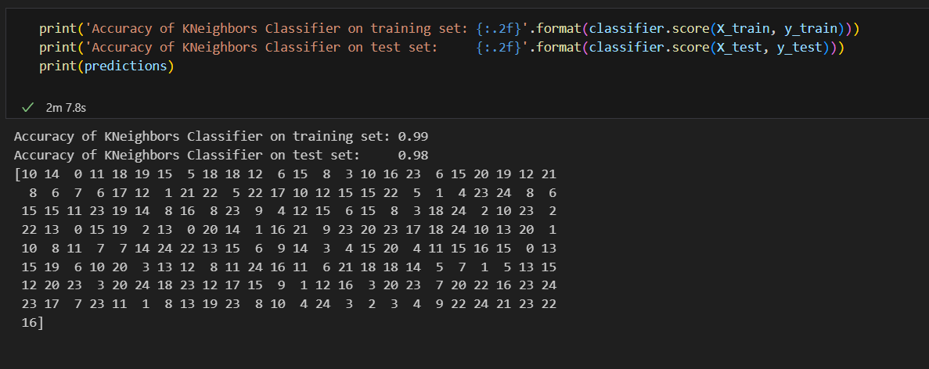

Slide 10
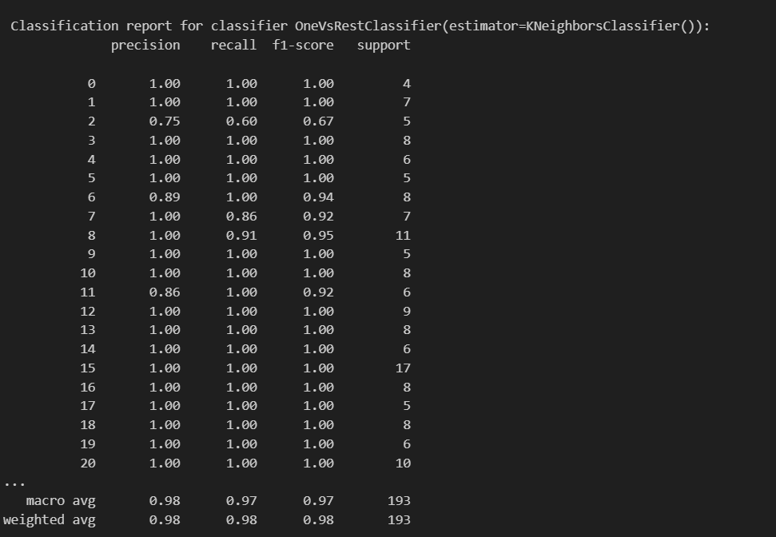

Slide 11
Future Scope/Conclusion:
In conclusion, this project results show that the effectiveness of the resume parser in helping both the efficiency and accuracy of screening process. By using Spacy for Natural Processing Language, Cosine Similarity for resume ranking and K-Nearest Neighbors for candidate matching, our application outperforms the traditional way of resume screening.
Moving forward, our main aim is to build a web application that can be user friendly. We also plan to incorporate additional customizable features and filters. Overall, this approach is a promising opportunity to transform the manual screening to a more automated task.

Slide 12
Reference
https://www.irjmets.com/uploadedfiles/paper//issue_4_april_2023/37428/final/fin_irjmets1683342426.pdf
https://www.researchgate.net/publication/361772014_RESUME_PARSER
https://arxiv.org/abs/1301.3781

Slide 13

THANK YOU

